Slide 1

Stephanie1@greencalgary.org
Reduce
Reuse
Waste and our World
Home school activities:
Week one
Recycle
Rethink
Breanna@greencalgary.org

Slide 2

Thanks for joining our home school activity!
Green Calgary will be sharing sustainable activities for you to enjoy from home.
Each week these activities will be based on a different theme.
Our theme for week one is:
Waste and our World!
Take part in our activities to reduce your waste at home.

Slide 3
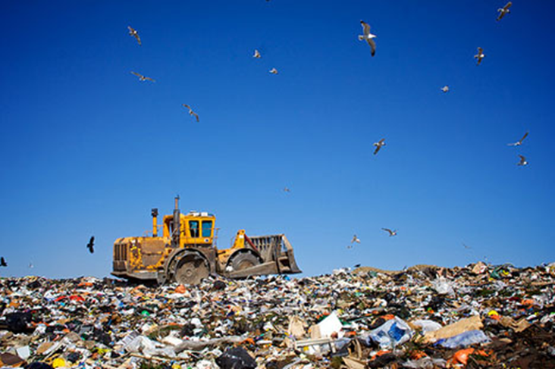
This is photo of one of the landfills in Calgary.
Trucks are used to compress the garbage. However, this means that there is very little oxygen in the landfill so decomposers cannot survive. As a result, decomposable garbage (such as apple cores and banana peel) does not break down in the landfill.

Slide 4
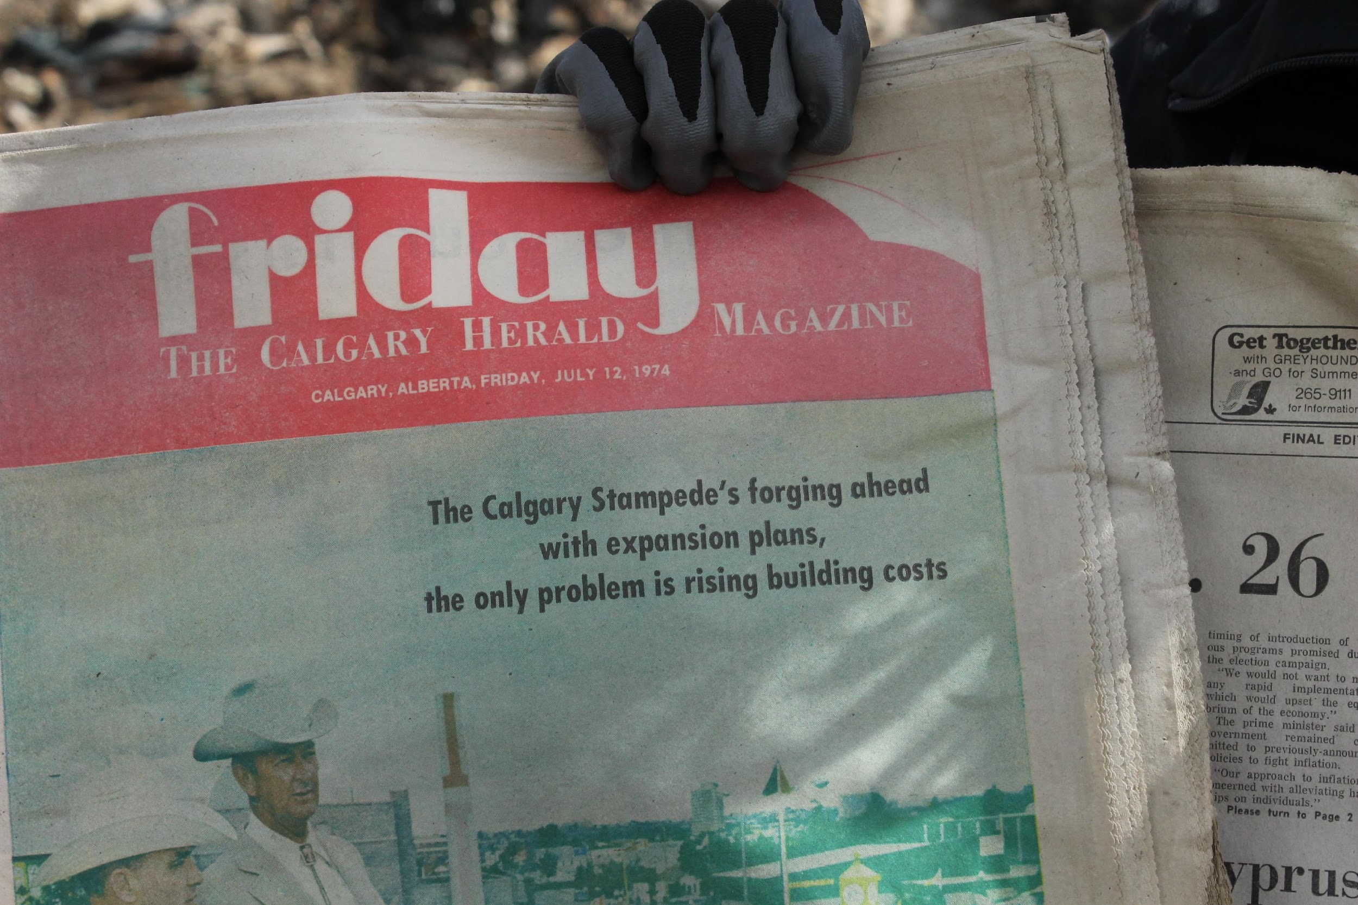
Leachate and rainwater buildup
Bullet points
This newspaper was buried in a landfill over 40 years ago!

Slide 5
Do you think everything in here needs to be in the landfill, or could some waste be diverted?

Slide 6
Waste can be separated into your black cart (other waste), blue cart (recycling) and green cart (compostable waste)
Notes:
How much of the waste going to our landfills is actually garbage?

Slide 7
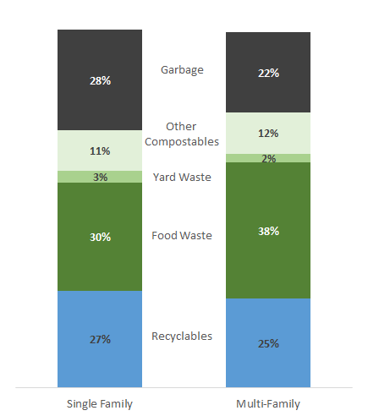
How much of the waste going to landfills is actually garbage?
Data source: City of Calgary (stats from 2019)

Slide 8
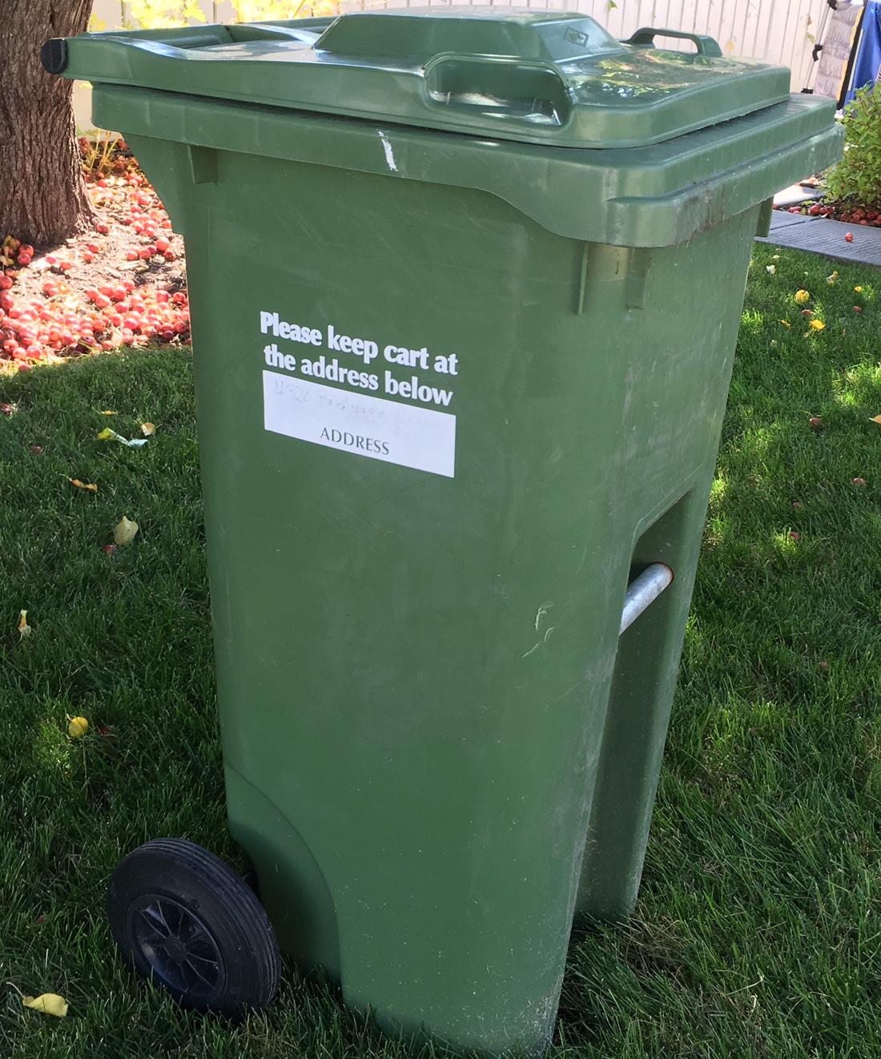
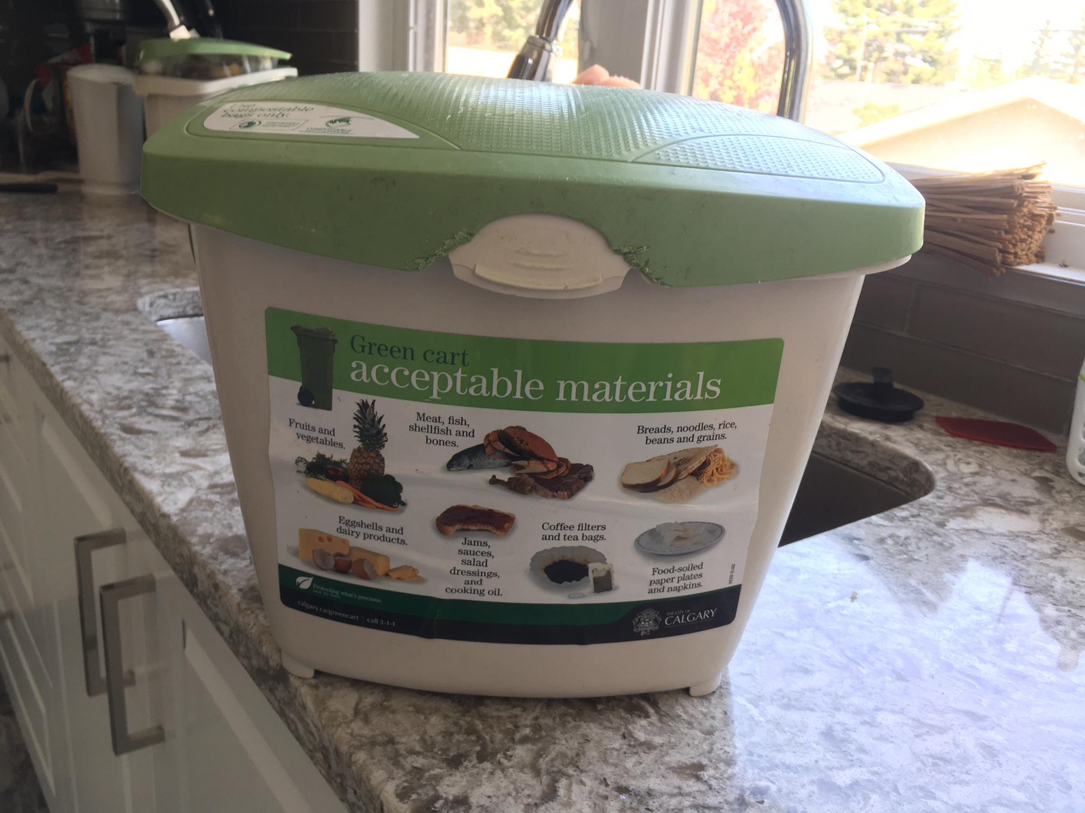

Green Carts
Notes:
Put your green cart out for collection every week there is compost collection in your community. You can find out when by downloading the Garbage Day App created by the City of Calgary – it will give you notifications for when organic, recycling and garbage pick up is happening on your street!
Keep the lid of the kitchen pail and green cart closed.
Empty your kitchen pail into your green cart every 2-3 days.
Consider freezing meat and fish waste until collection day - especially during warm weather.
Sprinkle a small amount of vinegar or baking soda in your kitchen pail and green cart to minimize odour.
Capture fruit flies with a bowl of vinegar covered with plastic wrap with several small holes in it. Empty as required.
Clean carts and pails
Use a compostable bag, paper bag or newspaper liner in your kitchen pail. If using compostable bags, ensure you use certified compostable bags, not plastic bags! These products will have the logos above on the box. Co-ops green compostable bags are certified compostable.
Layer your green cart to keep material from sticking. Place crumpled newspaper on the bottom of your cart and alternate layers of kitchen waste/grass clippings with soiled newspaper or leaves.
Rinse your kitchen pail with hot water or place inside your dishwasher.
Rinse your cart and pour the dirty water onto grass/gravel, not down the storm drain.
Storage best practices
Store your kitchen pail under the sink or on the counter for easy access.
Store your green cart in your garage or in another shady spot in warm weather.

Slide 9










What can go in your green cart?
Eggshells
Coffee filters/teabags
Plate scrapings
Meat, fish and bones
Fruits and vegetables
Bread, noodles, rice
Beans and grains
COMPOSTABLE bags
Notes:
If you’re ever confused about what waste should be going where (black, green or blue cart), check out: https://www.calgary.ca/UEP/WRS/Pages/What-goes-where/Default.aspx
You can look up the item and it will tell you how to dispose of the item!

Slide 10
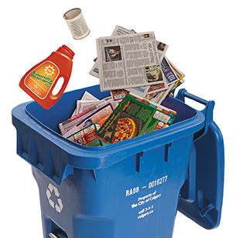
Don’t forget to use your Blue Cart

Slide 11
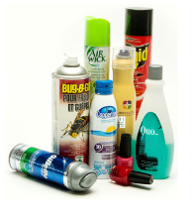
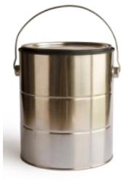
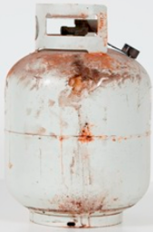
Did you know our City has Throw’n’Go Stations?
Notes:
Throw’n’Go stations at the City Landfills are for materials that you cannot safely dispose of through our black, green and blue cart system in place. It is important to know which items these are, as many of the items are harmful or hazardous to the health of the environment, as well as to humans! We recommend having a secure designated box or container to store these items in and to collect them until it is full, prior to bringing to the Throw’n’Go station. That way, you’re not making multiple trips!
Below are some items you can start putting aside to bring to the Throw’n’Go once you’ve gathered a large enough collection.
These items are free to drop-off:
Electronics (end-of-life)
Some household chemicals, motor oil, aerosol cans
Used clothing, shoes or textiles – these can also be donated to local charities and thrift stores near you!
Christmas trees
Find details about what types of these materials are accepted here: https://www.calgary.ca/UEP/WRS/Pages/Landfill-information/Landfill-Throw-n-Go-Facilities.aspx
These items have a charge for disposal:
Mattresses
Couches/sofas
Refrigerators and freezers
Vacuums
Dishwashers, washers, stoves, dryers
BBQs, lawnmowers
Yard waste
Construction and demolition materials
Paper
See details about the charges here: https://www.calgary.ca/UEP/WRS/Pages/Landfill-information/Landfill-Rates.aspx

Slide 12

Thank you for taking part!
Look out for our home school activities on our website.
Proudly Supported by:

