Slide 1

Stephanies@greencalgary.org
Breanna@greencalgary.org
Waste
Compost
Vermicomposting – composting with worms!
Home school activities:
Week ten
Worms
Garden

Slide 2
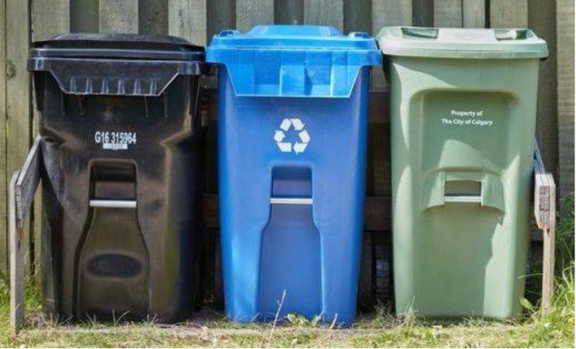

What is waste?
Waste is anything that is set out for collection and includes garbage, recyclable material, and food and yard waste material.

Slide 3
Do you know the 3 R’s?
Reduce, Reuse, Recycle
What activities do you do at home to reduce your waste?

Slide 4
What is compost?
Compost is decayed organic matter. Basically, anything that comes from something living can be composted – banana peels, leaves, twigs, egg shells, animal bones…

Slide 5
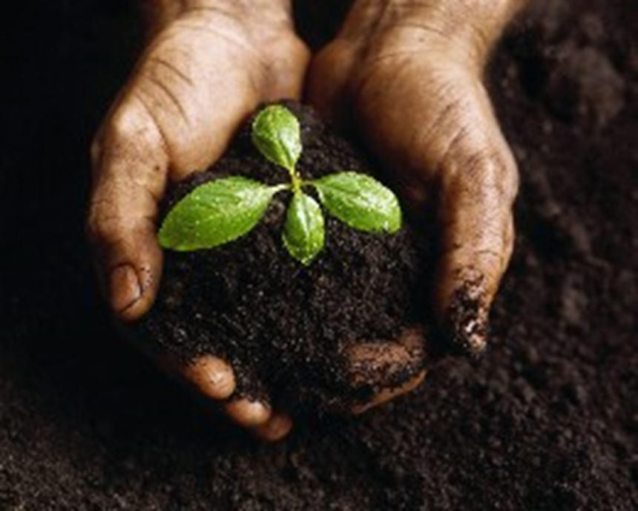
Compost is rich in nutrients so it’s a fantastic fertiliser which helps us to grow new things.

Slide 6
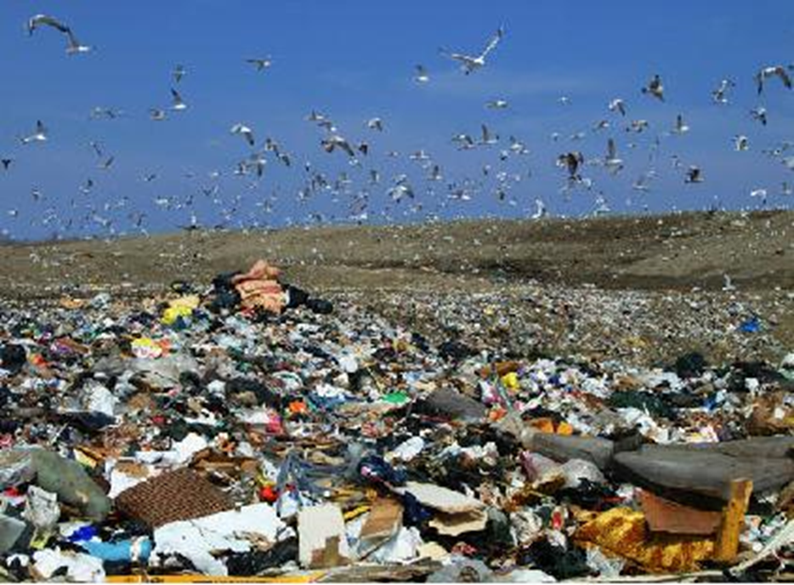
Composting helps to reduce the amount of organic waste sent to landfills

Slide 7
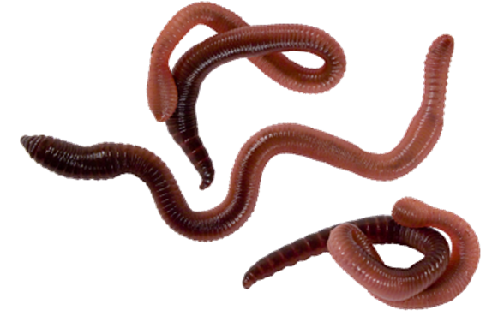
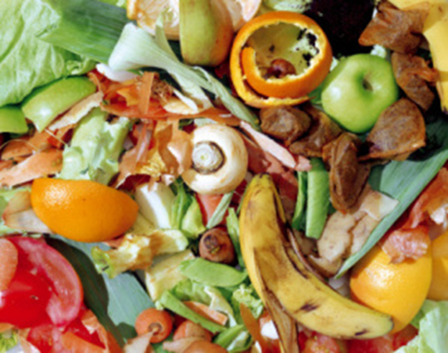
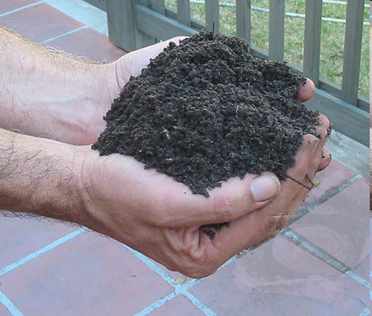
What is vermicomposting?
Notes:
Vermicomposting is the use of worms to break down material into compost.

Slide 8
What is vermicomposting?
Worms eat the waste material and their poop can be used as compost.
Notes:
Vermicomposting is the use of worms to break down material into compost.

Slide 9
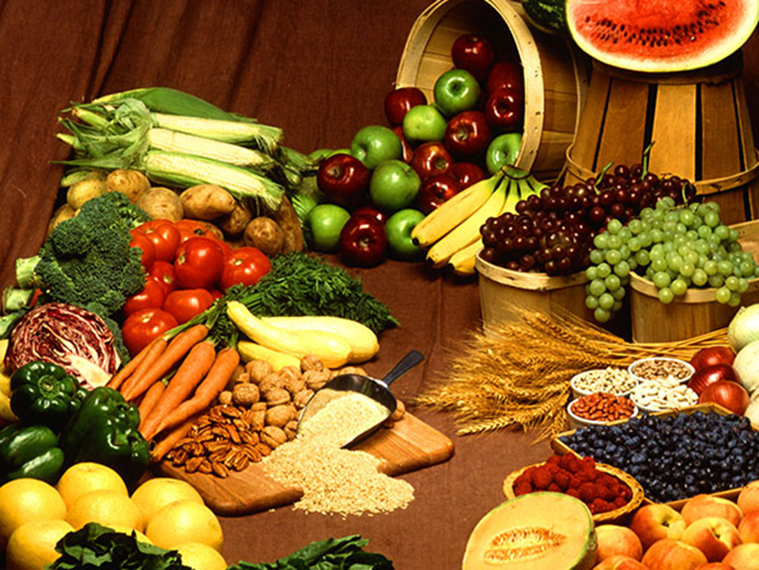
What makes worms so good at composting?
Guess how much worms can eat in one day.
Half their body weight every day!

Slide 10
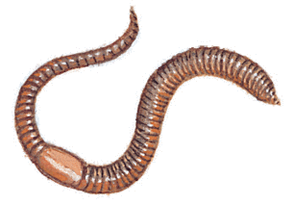
What do worms like to eat?
Activity time!
Yum!
Try the activity on our website

Slide 11
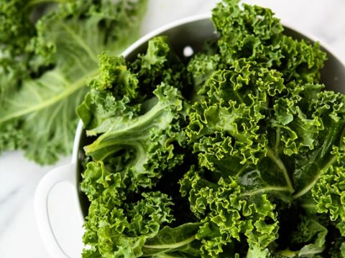
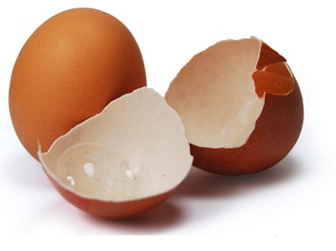
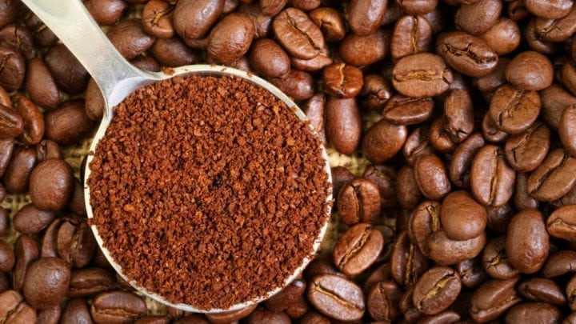
What do worms like to eat?
Yum!

Slide 12
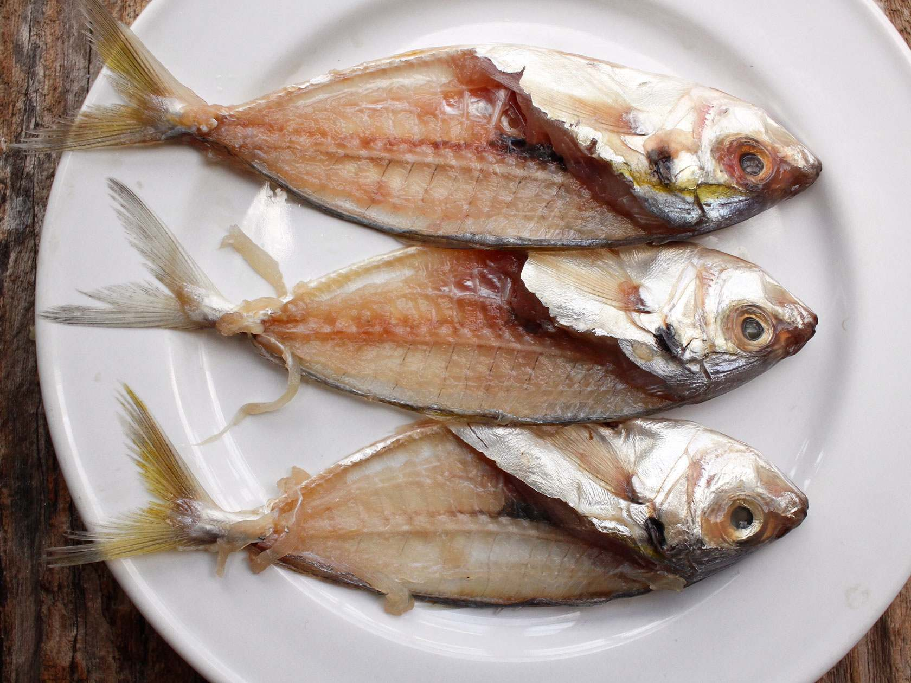
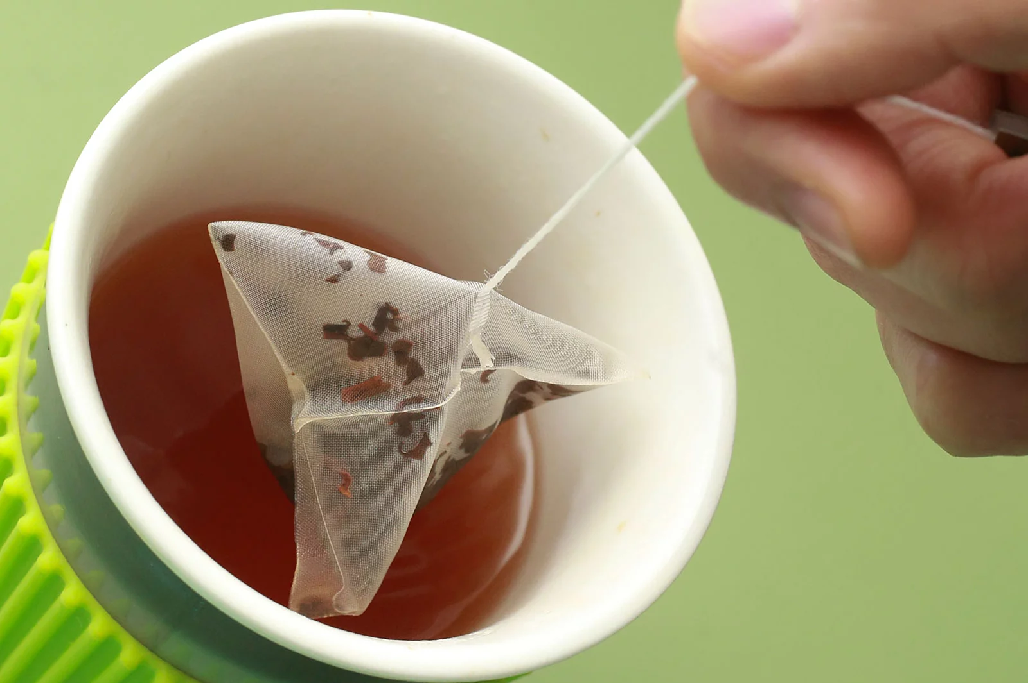
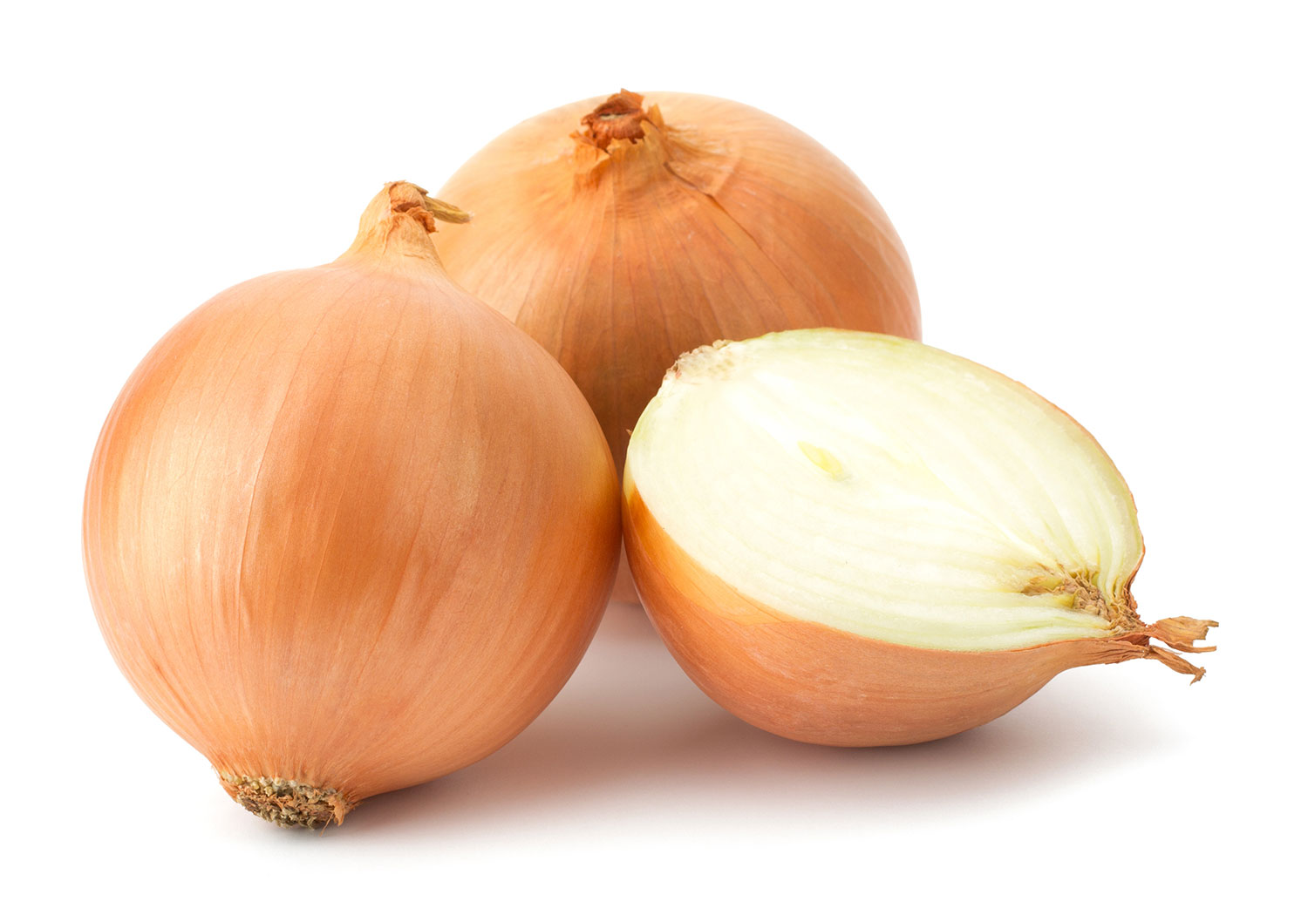
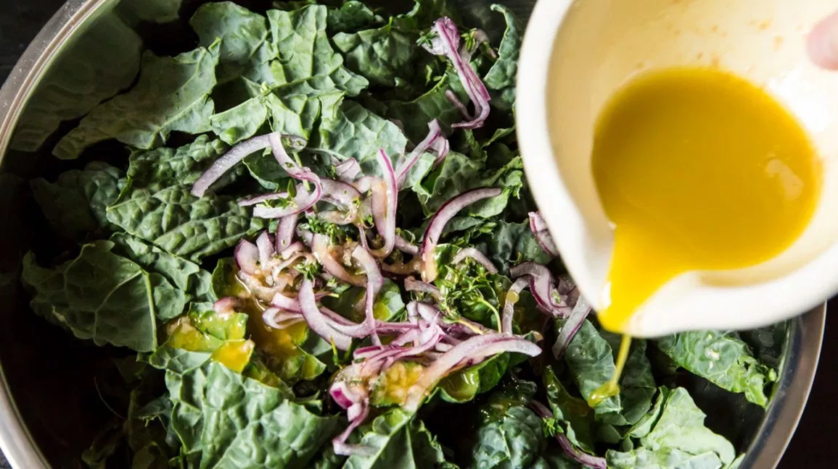
What do worms like to eat?
No thanks!

Slide 13
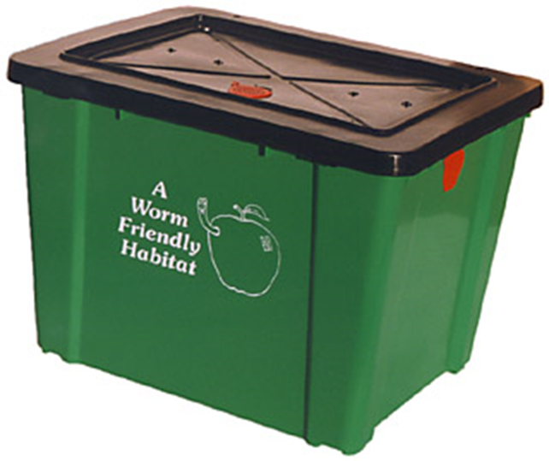
Some people keep worms at home as a way to make compost.
They need:
Shredded newspaper
Food
Worms
More newspaper
A lid

Slide 14


Proudly supported by:
Thank you for taking part!
Look out for our home school activities on our website:
www.greencalgary.org

